Slide 1
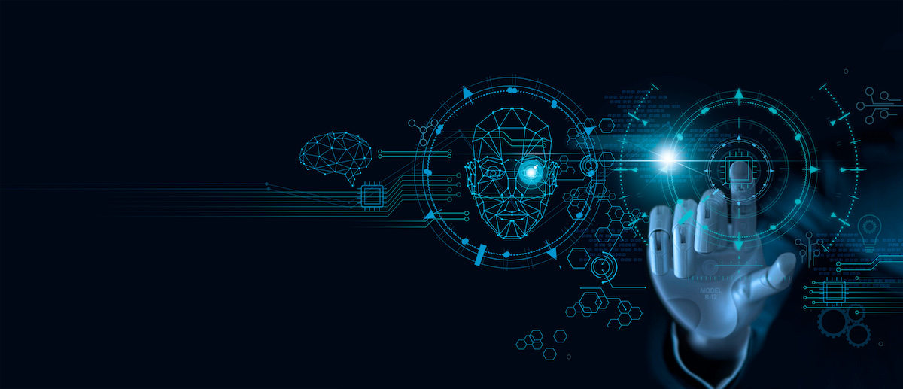
The Applications of ML in Real World Problems

Slide 2

Machine Learning (CSE 465)
Presented to
Badhan Chandra Das Lecturer Department of CSE Bangladesh university of Business and Technology (BUBT)
Presented by
Mohammad Sabbir Ahmed | 17183103004
Syeda Nowshin Ibnat | 17183103020
Rakibul Ahasan | 17183103022
Sheikh Abu Hanif | 17183103043
Nusrat Jahan Anka | 17183103008
Intake: 39(2), Dept. of CSE, BUBT
Presented Date: 07-03-2022

Slide 3
Contents
04
Conclusion
03
Real World Applications
02
Overview
01
Introduction

Slide 4
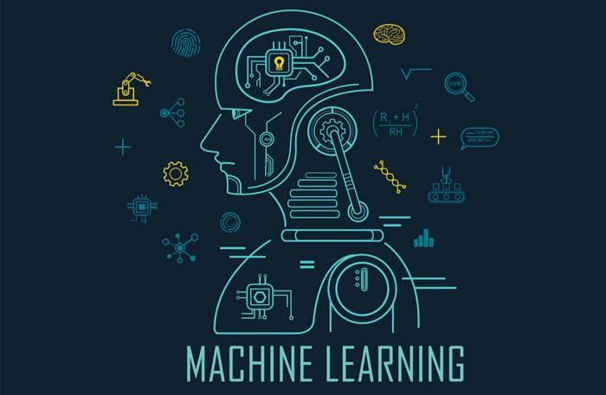
Introduction

Slide 5
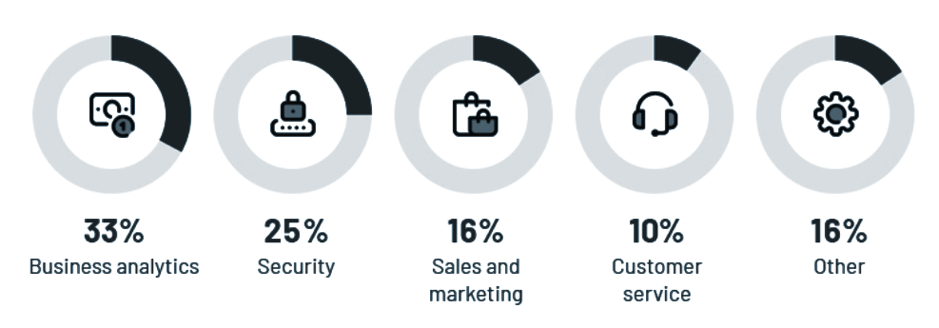
Leading Applications of ML in 2021
Source: Statista

Slide 6
Overview
Healthcare and Bioinformatics
ML Applications in Real Life
Traffic Prediction
Speech Recognition
Smart Device and Technologies

Slide 7
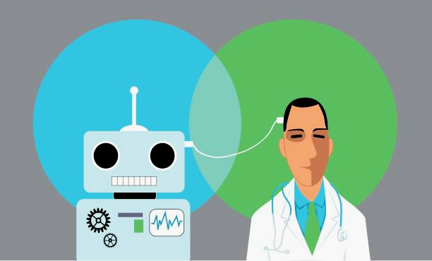
Healthcare and Bioinformatics
Machine learning in healthcare and bioinformatics is becoming more widely used and is helping patients and clinicians by overcoming industry challenges and creating a more unified system to improve work processes.
Source: techcrunch.com

Slide 8
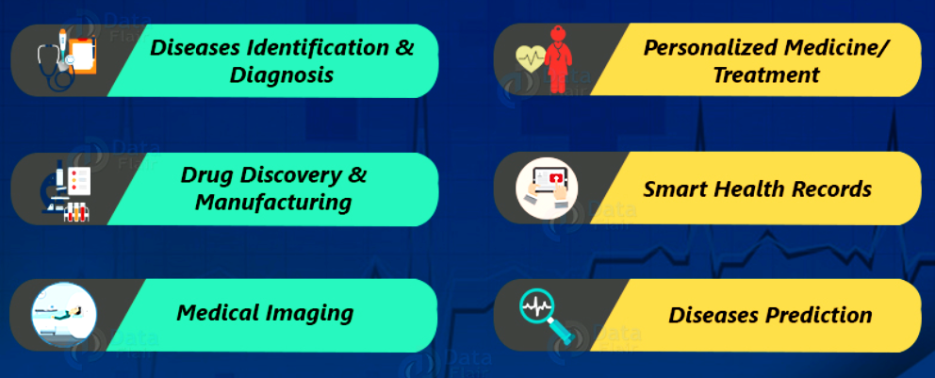
Real World Applications
Source: ddata-flair.training

Slide 9
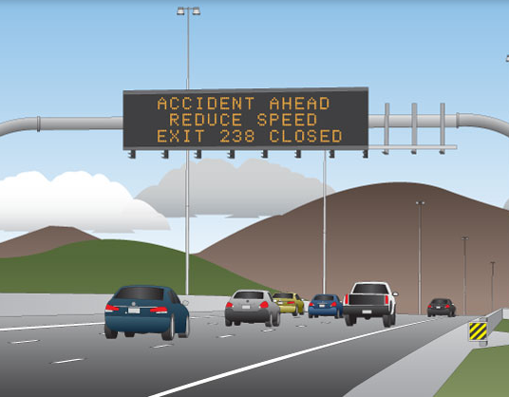
Traffic Prediction
Traffic prediction means forecasting the volume and density of traffic flow, usually for the purpose of managing vehicle movement, reducing congestion, and generating the optimal (least time- or energy-consuming) route.
Now i will
The main
plan

Slide 10
Who needs it, and why is it important?
Traffic prediction is mainly important for two groups of organisations :
National/Local Authorities: In the last ten to twenty years, many cities adopted intelligent transportation systems (ITS) .These systems use current traffic information as well as generated predictions to improve transport efficiency and safety by informing users of current road conditions.
Logistics Companies: Another area of implementation is the logistics industry. Transportation, delivery, field service, and other businesses have to accurately schedule their operations and create the most efficient routes.

Slide 11
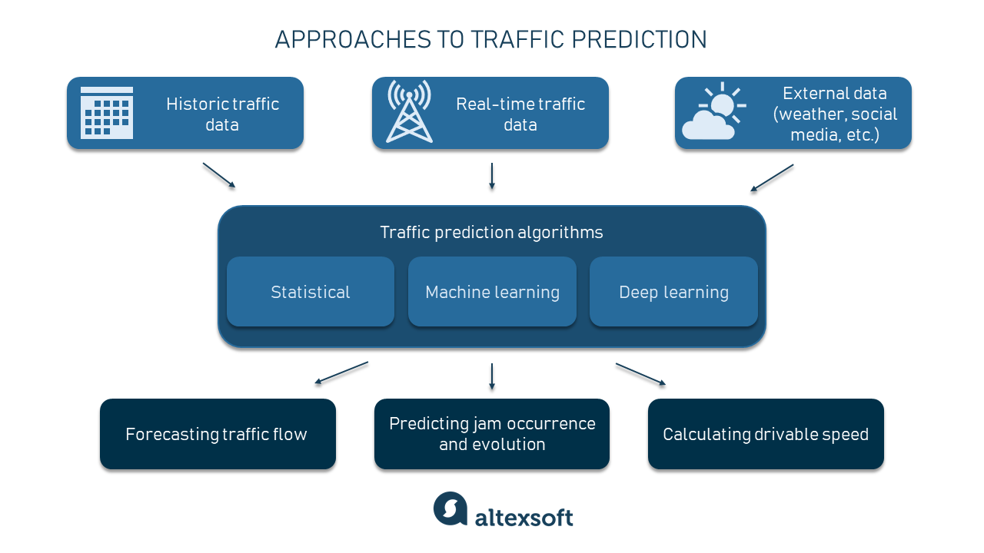
How to implement traffic prediction
Let’s take a look at different approaches to this task :
Statistical approach : They are usually easier, faster, and cheaper to implement than machine learning ones.
Machine learning approach : Numerous studies have been conducted on the application of ML algorithms to forecast road traffic.
Deep learning approach : Deep learning (DL) methods have proved highly effective comparison other techniques.
National/Local Authorities
can’t process multivariate data

Slide 12
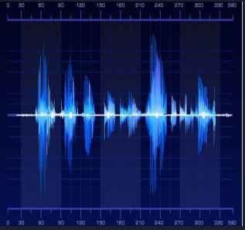
Speech Recognition
While using Google, we get an option of “Search by voice”, it comes under speech Recognition, and it’s a popular application of machine learning. Speech recognition is a process of converting voice instructions into text, and it is also known as “Speech to text”, or “Computer speech recognition”. At present, machine learning algorithms of are widely used by various application of Speech recognition.

Slide 13
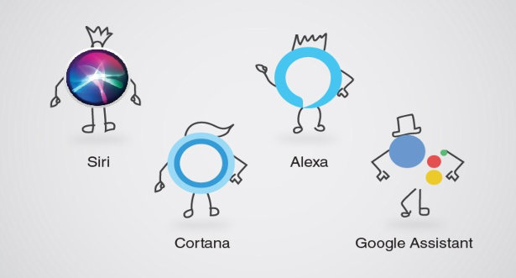
Speech Recognition Example

Slide 14

Smart Device and Technologies
Machine Learning is a promising technology to extract accurate and valuable information from smart devices and technologies. IT can also enable the smart devices to learn without use of explicitly programming.

Slide 15


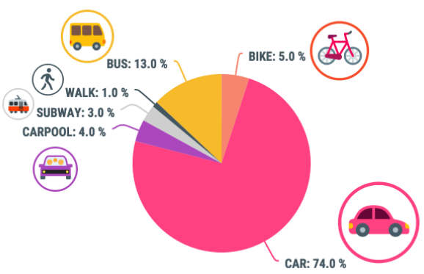
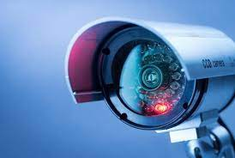
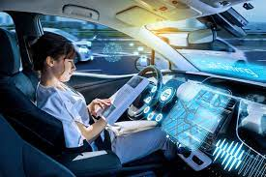

Smart Device and Technologies Cont.
Online Support using Chatbots
Commute Predictions
Video Surveillance
Autonomous Cars
Virtual Assistant

Slide 16
Conclusion
These days, machine learning techniques are being widely used to solve real-world applications. Research in ML has been vigorous and fruitful, and we can look forward to a continuation of good work in this area.

Slide 17
Reference
Machine Learning and Real-World Applications - slideshare
Top 10 Real-World Machine Learning Applications
Machine Learning - GeeksforGeeks
Machine Learning: Algorithms, Real-World Applications and Research Directions | SpringerLink
AI and ML use case frequency 2021 | Statista

Slide 18
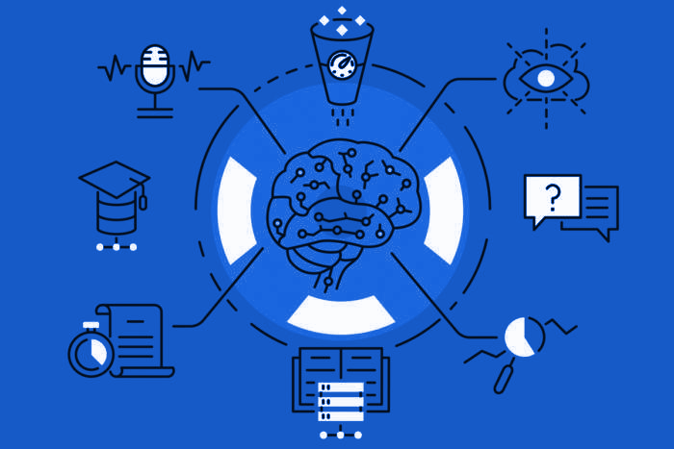
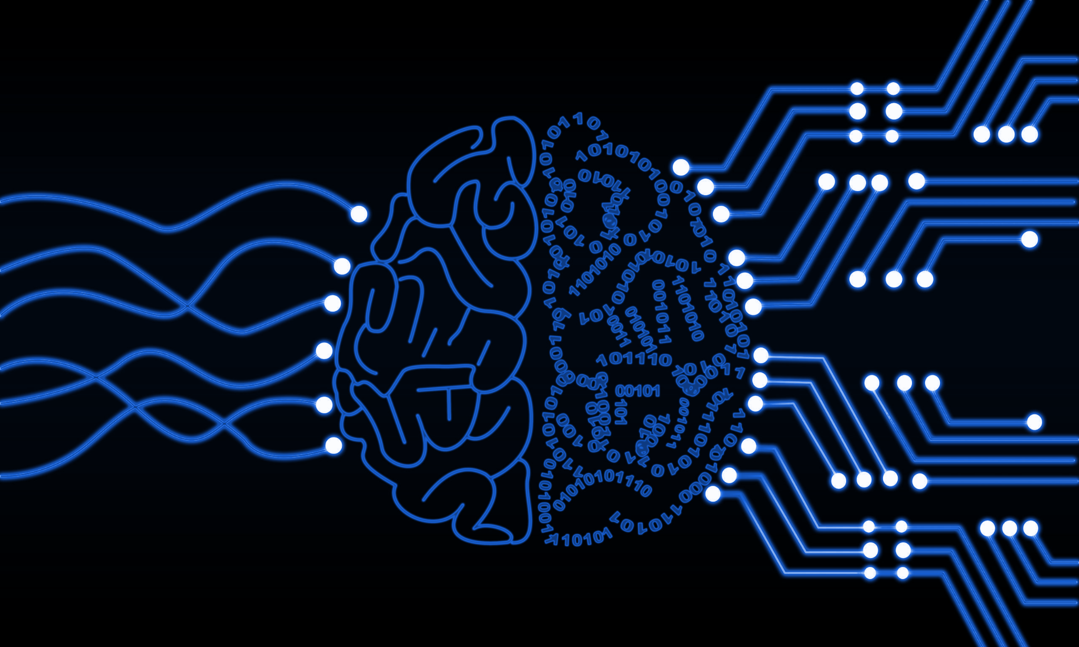

Thank You!

